Slide 1
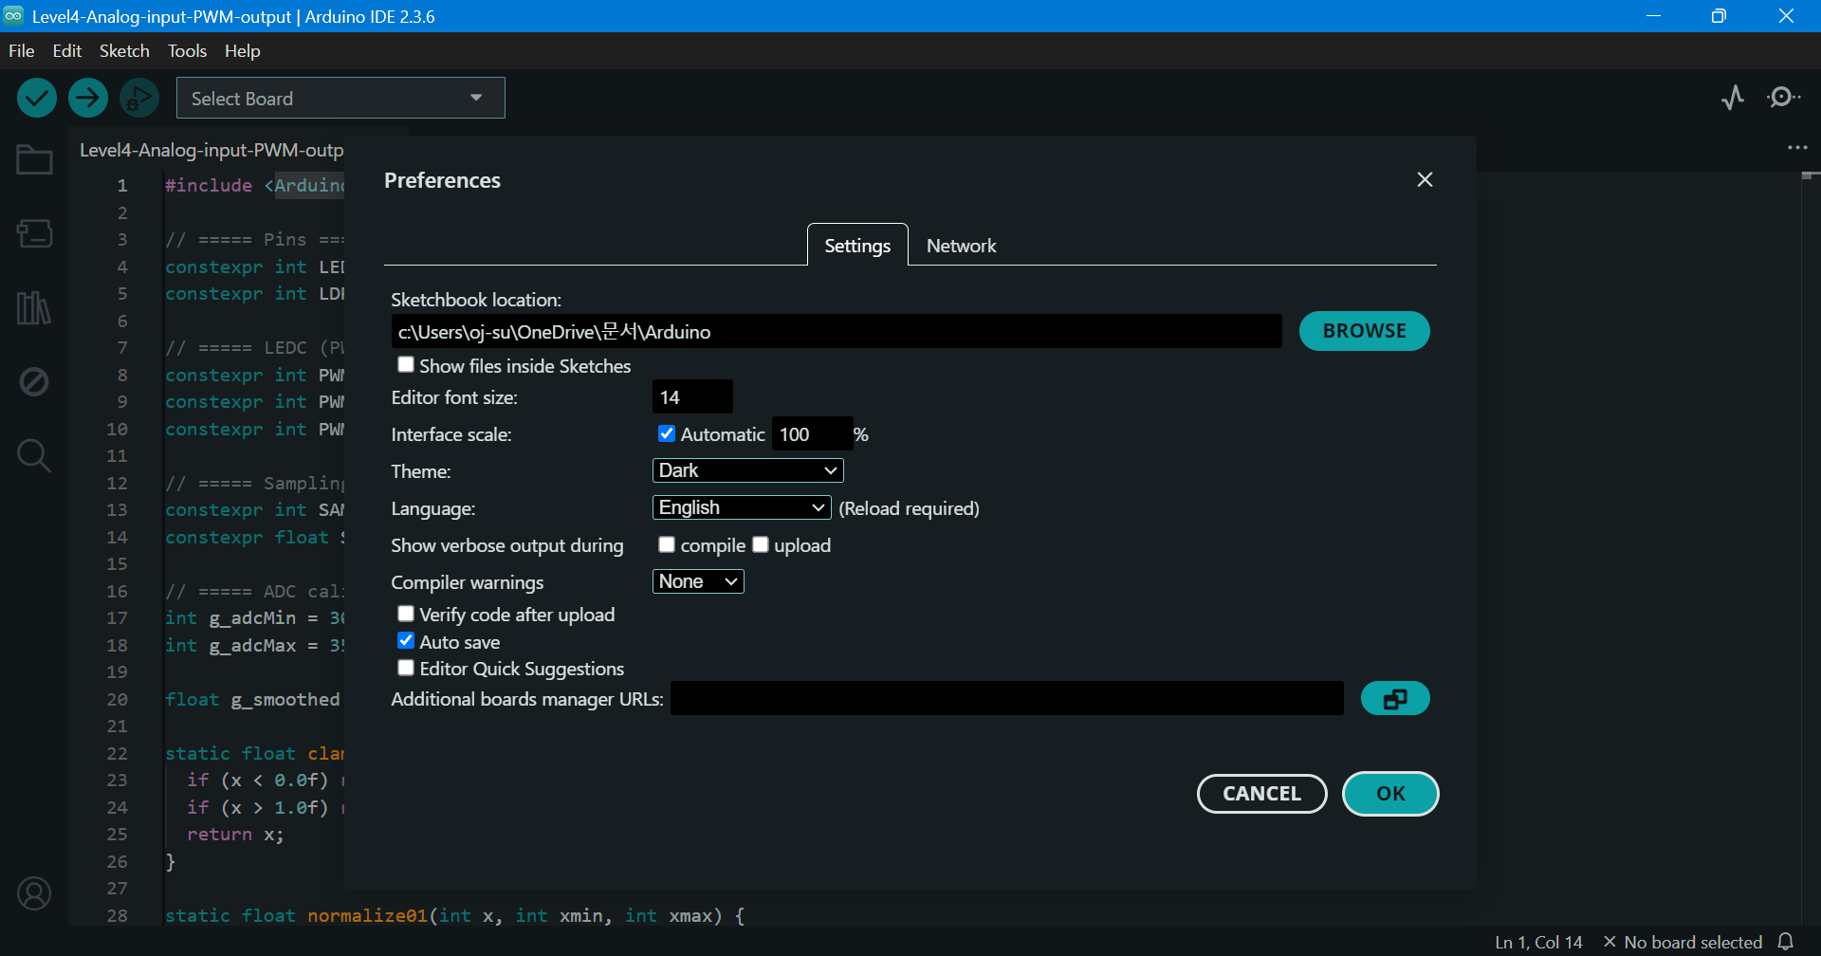
ESP32 Board Package Installation
File → Preferences
https://dl.espressif.com/dl/package_esp32_index.json

Slide 2
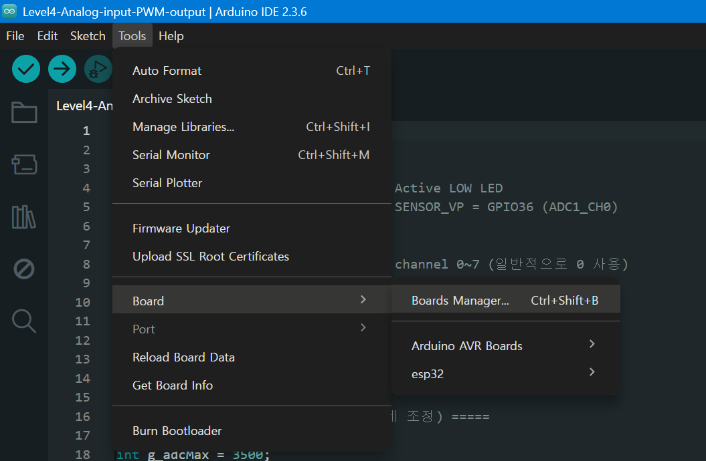
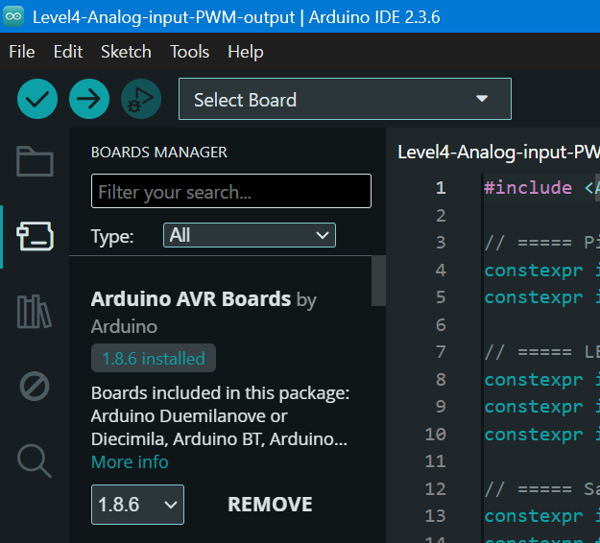
ESP32 Board Package Installation
Tools → Board → Boards Manager
Search ‘ESP32’

Slide 3
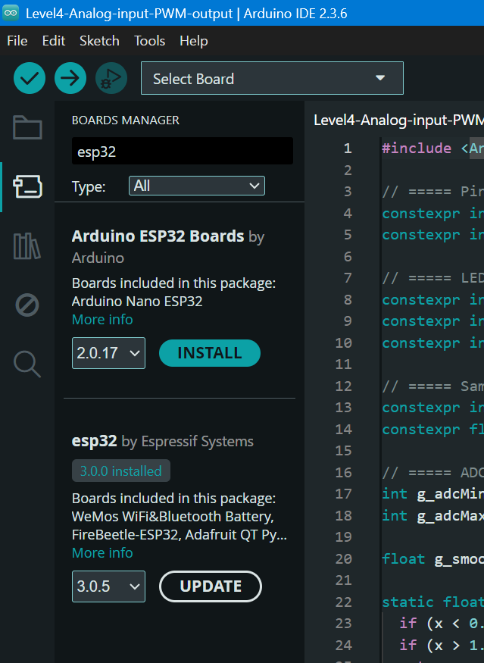
ESP32 Board Package Installation
Choose:
ESP32 by Espressif Systems
✔ and click ‘Install’

Slide 4
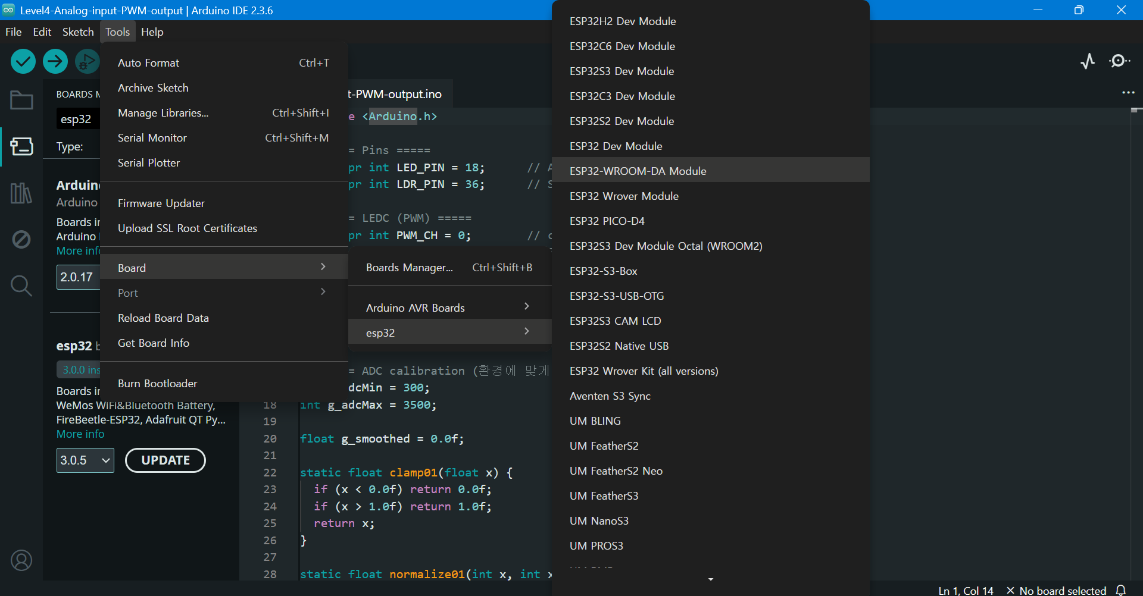
ESP32 Board Package Installation
Tools → Board → ESP32-WROOM DA Module

Slide 5
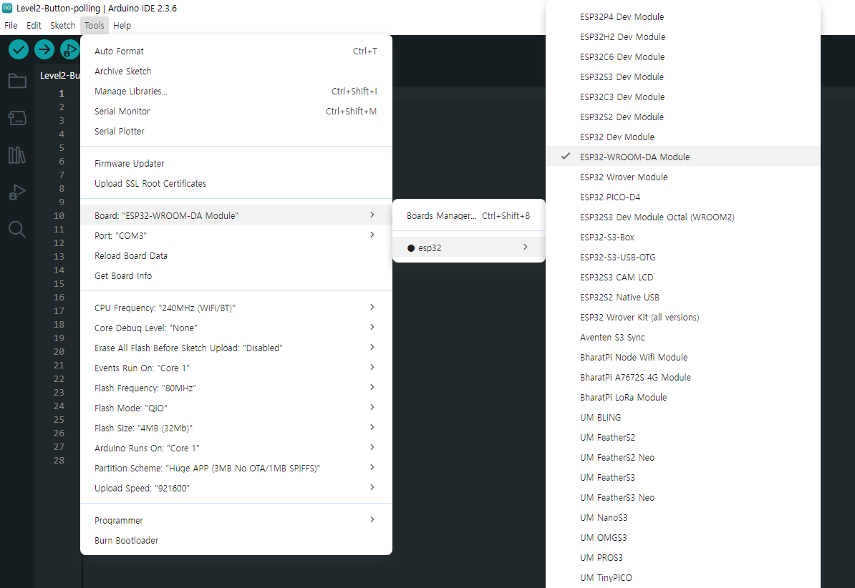
ESP32 Board Package Installation
After connecting the board and PC by a USB cable,
Tools → Board

Slide 6
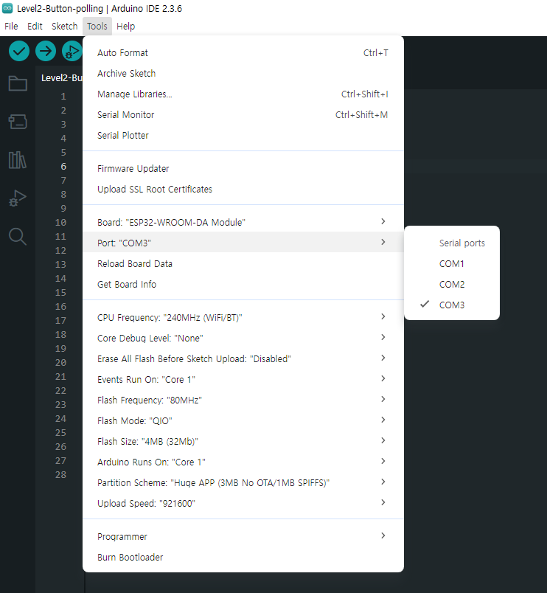
ESP32 Board Package Installation
Tools → Port

Slide 7
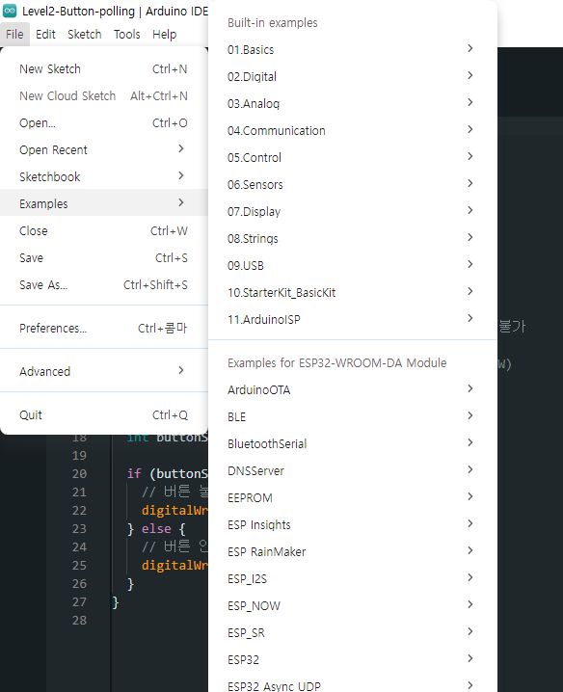
ESP32 Board Package Installation
File → Examples

